Slide 1
R-NAUGHT
Kevin Sani Paul Babu Nowfir K.N
Roll no: 25 Roll no: 35 Roll no:34
S7 B-TECH CSE
GUIDE: Dr. SUREKHA MARIAM VARGHESE
DEPT. OF COMPUTER SCIENCE AND ENGINEERING , MACE KOTHAMANGALAM
JUNE 2021
Notes:
We Kevin ,Nowfir and Paul , along with our guide Dr. Surekha miss is presenting here rnaught, which we together believe is the future of health monitoring apps
Here we took inspiration from the pandemic and have designed a product taking corona virus and its different variants as a case

Slide 2
CONTENTS
Introduction
Objective
R-Naught
Justification of Project
Existing apps
Existing Flaws
COVID-19 Tracing
Implementation
Result
Conclusion

Slide 3
INTRODUCTION
COVID-19, the pandemic world is currently facing
Contact tracing - efficient method to reduce covid cases
Current systems lack adequate information
Notes:
We all are facing difficulties of the pandemic and how to reduce the spread and the most popular answer is Quarantining
Seemingly simple, contact tracing is the process of identifying all people that a COVID-19 patient has come in contact with in the last two weeks.
Contact tracing becomes complicated and time-consuming very quickly. Especially in the context of COVID-19, as the virus can be transmitted between people without even manifesting symptoms.
The necessitates the need of more than 1 level of contact tracing and unfortunately current tracing apps doesnt consider this
And so,We have designed the app rnaught which helps to keep a check of different variants of corona by encouraging self isolation , using strict and efficient contact tracing

Slide 4
OBJECTIVE
To develop an application to compute the probability of infection of contagious diseases like COVID-19 with the help of graph database on the basis of multiple level contact tracing using contact time, level of contact, age, etc., as parameters
To make a calculated assumption to identify the patient zero(source) from a set of covid positive patients
Notes:
To develop an application to compute the probability of infection of contagious diseases like COVID-19 with the help of graph database on the basis of multiple level contact tracing using contact time, level of contact, age, etc., as parameters
To make a calculated assumption to identify the patient zero(source) from a set of covid positive patients

Slide 5
R-NAUGHT
Every virus has a basic reproduction number
Average number of additional people infected person infects
The number depends on:
Virus transmissibility
Community behaviour
Notes:
Every virus has a basic reproduction number.R-naught is the average number of additional people that one person with the virus will infect. That number depends not only on how transmissible the virus is, but also how easy or difficult the behavior of the community makes it for the virus to spread. Estimates published in Nature on March 18 suggest the R-naught of COVID-19 is between 2 and 2.5.
Because we try to counter the r naught measure, we ironically chose to name out app r naught

Slide 6
JUSTIFICATION OF PROJECT
Need to identify source and possible contacts
Spread control by isolating right people
Using Neo4j Graph Database:
Faster processing
Ease of mapping data
Need to consider factors boosting virus spreading
Efficient exposure prediction
Notes:
Why RNaught
As we know we Need to identify the source and possible contacts as soon as possible
And hence,We can control the spread by isolating the right people -> This is the main purpose of our application
And Why we used neo4j,
Neo4j being a graph database gives more importance to relation which in our case is contacts , and helps querying contacts efficiently rather than using multiple joins in a traditional database
Because we consider different factors to find exposure we have a better chance of isolating the right person

Slide 7
EXISTING APPS
Arogya Setu (India)
COVIDSafe (Australia)
COVID Alert (Canada)
Health Code (China)
NHS COVID-19 (United Kingdom)
Notes:
These are few of the existing apps, there are a lot of them globally

Slide 8
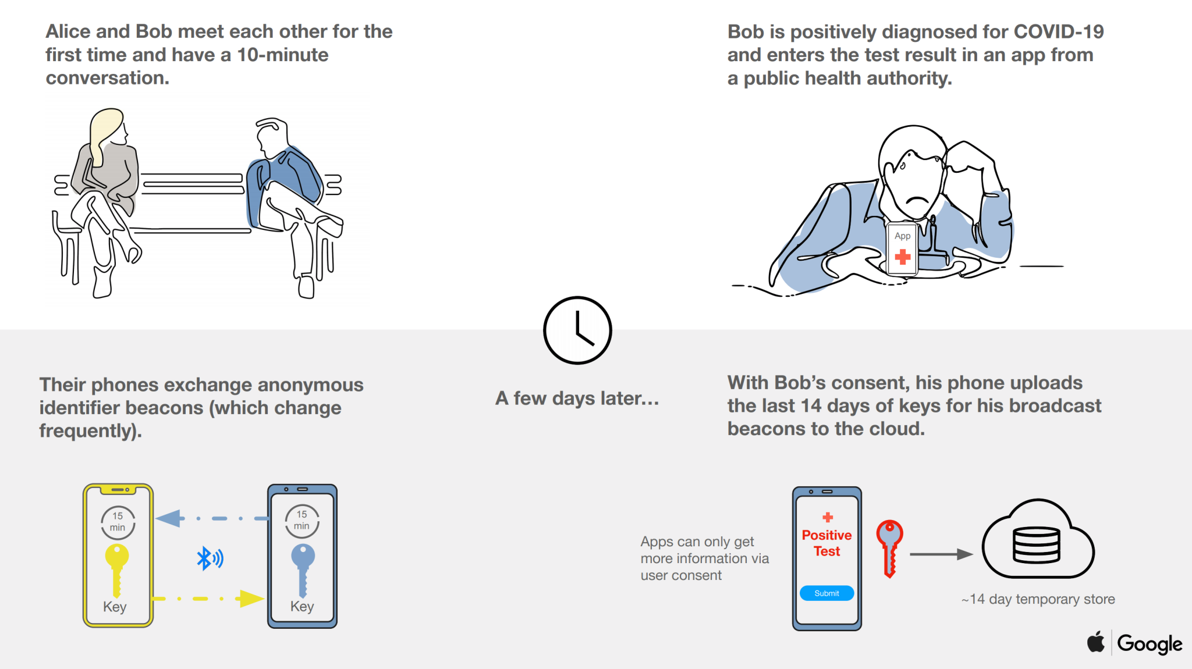
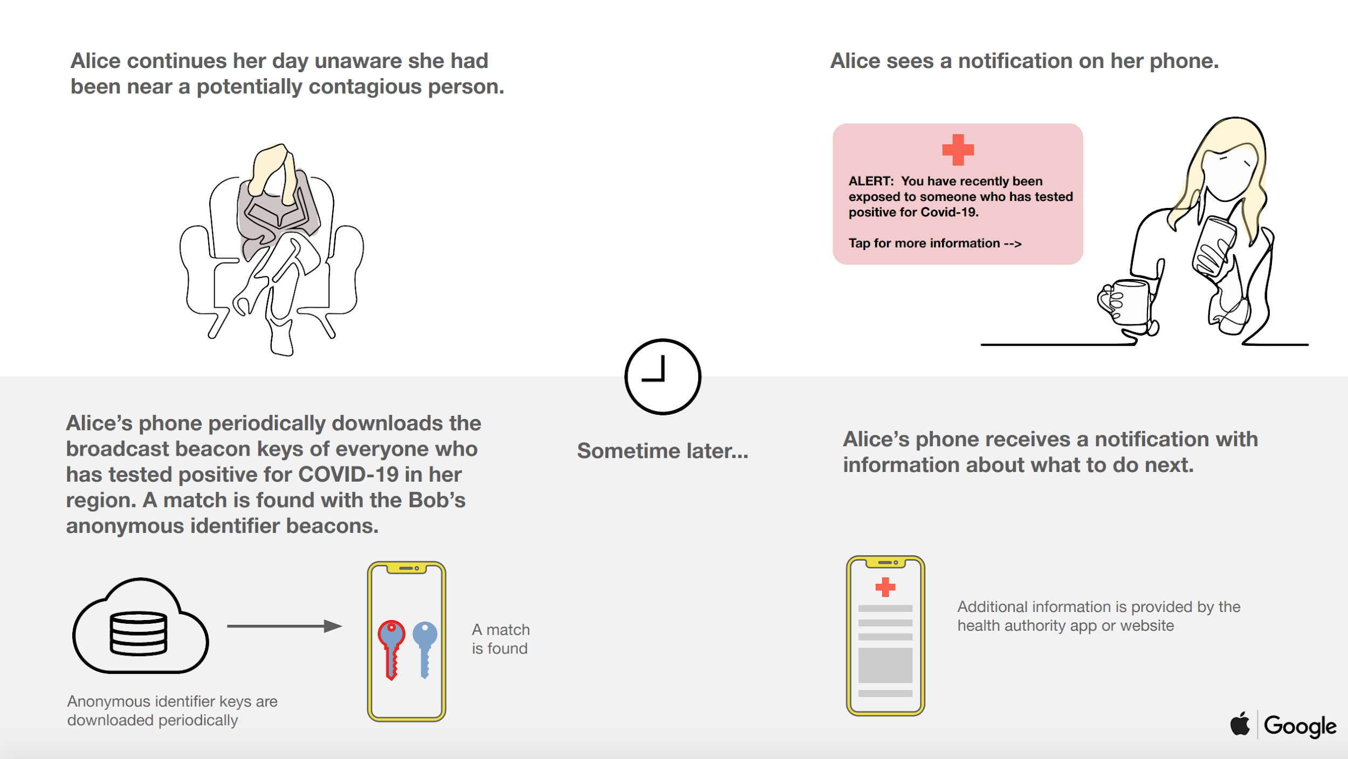
EXISTING APPS-GENERAL WORKING
Sends unique random code using Bluetooth
Listens for message from nearby devices
Infected - send contact details to hospital database (authentication)
Contacts warned to self-quarantine
Notes:
Let’s see how it works with the help of alice and bob
Alice gets a tracing app
Every 5 minutes , her phone send unique random code to all nearby devices using bluetooth
Now while her phone sends out random messages it also listens for messages from nearby phones. I.e Bob Here
When alice and bob stays close there phones will exchange unique codes
Both There phone remembers all the unique codes they heard over last 14 days
Next day is a bad day for Bob, he gets tested and has covid 19
Bob uploads all his contact ids to hospital database by one time passcode given by dr,
Alice Phone often checks hospitals list and see if she met any of them recently
If so her phone warns him to quarantine

Slide 9
EXISTING FLAWS
Inefficient tracing methods
No mapping of data
No feature to trace different variants of virus
No technique to find the source of virus
Lack of Privacy
Notes:
What are the flaws we identified, - Inefficient tracing methods
We know how fast and easily the virus spreads, and therefore it is not enough merely to see direct contacts, as they might be the carrier to secondary contacts
And there is a need to track different variants simultaneously as one could potentially be more dangerous
Certain apps marks location of people which also brought privacy concerns among the public as they used GPS instead of bluetooth

Slide 10
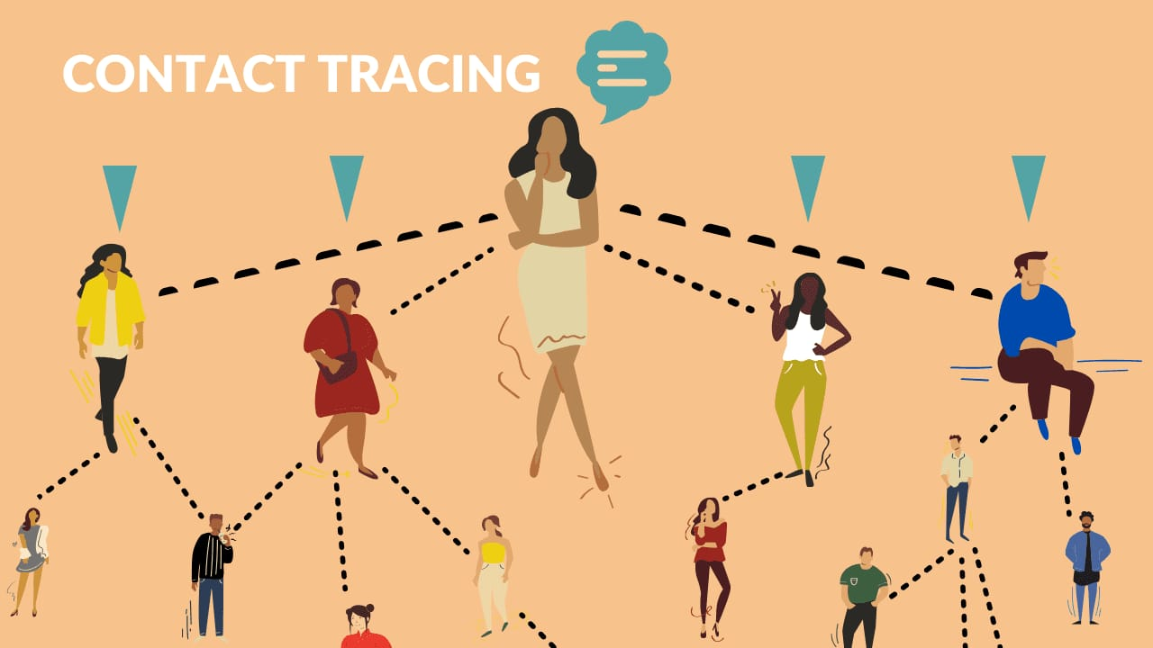
WHAT R-NAUGHT DOES
Contact data stored in graph database
Contact tracing up to five levels
Predicts chances of virus contraction
Uses parameters of disease spreading
Traces different variants of viruses
Helps officials know exposure measure of nearby person
Notes:
We work the exchange of codes same way as most other apps.
But instead of storing those in phone,it is stored in the graph database as contact between 2 nodes in the graph, Alice and Bob
Alice can be the topmost node here and Bob is a person in level 2. Consider a 3rd person in level 3 of graph, we can call her Janet
What we do when alice tests positive is , we go back ipto 14 days and find all of Alice’s contacts which includes Bob and all of bobs contacts after he met alice which includes Janet so on upto 5 levels
And we give Exposure chance percentages to all of them based on level of contact , duration of contact etc.
We dont generalise tracing it as corona, instead we trace different varieties of virus individually and therefore a more dangerous variant can be controlled more strictly
So, Alice was positive and we expect Janet to Quarantine herself, But Janets Favorite team was playing and she decides to go out to watch it
The option in Rnaught which allow officials to see the exposure measures will disallow Janet to the stadium and will ask her to Quarantine preventing Further Spread.

Slide 11
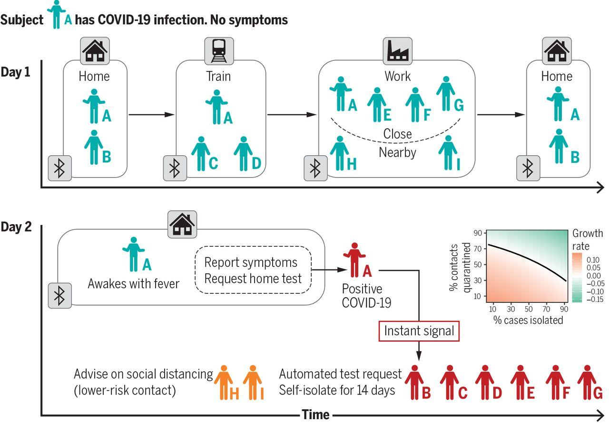
COVID-19 TRACING
Notes:
This figure shows how fast contacts happen and how fast it spreads. From home while travelling at work and so on. And How ppl are notified when one gets positive

Slide 12
IMPLEMENTATION
Notes:
Let’s move on to implementations

Slide 13
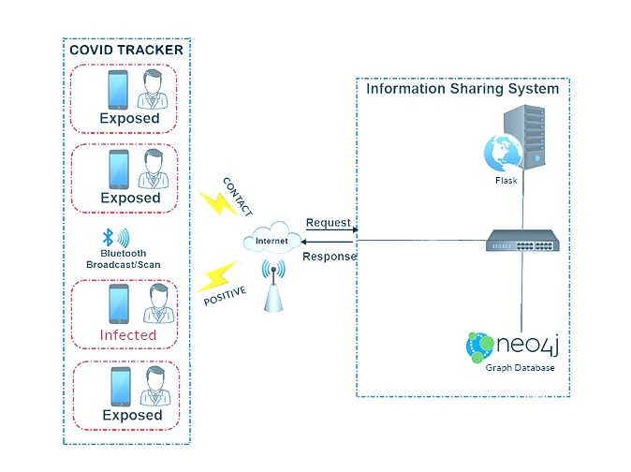
ARCHITECTURE
Notes:
Let’s look at the architecture first. The different components are: the front end application at user side which works on bluetooth broadcasting and scanning, neo4j graph database for storage of user details and contact information, flask server to query to and from graph and process data. Internet is in between to connect front end and backend.
When people comes in close proximity, their unique ids are exchanged via bluetooth and the contact information is send to backend. When a person is verified as positive and send to backend, flask server queries his contacts up to five levels and gives corresponding exposure measures to each level.

Slide 14
IMPLEMENTATION TOOLS
Beacon
Flask (Backend)
Flutter (Front End)
Neo4j (Database)
Notes:
These are the tools we used to develop our app. Let’s go through each of them in detail.

Slide 15
IMPLEMENTATION DETAILS
App Background
Created using flutter
Connection made with server using Http package
Unique Id created and sent to Neo4j server
Bluetooth connection made possible by Beacon package
Permission required for location access
Notes:
The front end is developed in flutter. We used flutter because of its cross-platform compatability, i.e., the same code can be used for android as well as ios with only small changes in plug-ins. Flutter is full of widgets, renders easily and thus apps build with flutter are faster. Also the language dart used in flutter is easy to learn.
Communication to and from server is done using http package in flutter, specifically post method in http package.
When a user registers with the app, a unique id is generated at the server, send to neo4j to create node in the graph and also received in the app.
Bluetooth connection is established using beacon package in flutter. Location permission is required for the beacon to work. Let’s see what a beacon is.

Slide 16
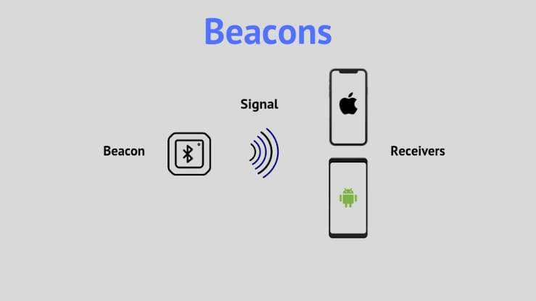
BEACON OVERVIEW
Why Beacon?
Astounding Accuracy
Lower Battery Consumption
Range upto 230 feet
Easy to use and implement
Notes:
At the initial stages, we were having troubles connecting phones via bluetooth because we were using flutter_ble package. The signal strength was weak and ranging was not accurate. So we moved to Beacon.
Beacons are small, wireless transmitters that use low-energy Bluetooth technology to send signals to other smart devices nearby. Simply speakng, they connect and transmit information to smart devices making location-based searching and interaction easier and more accurate. With beacon package, our app makes the device into a beacon device as well so that it broadcasts bluetooth signals.
Beacon provides high accuracy in proximity calculation. It provides rssi value (received signal strength indication value) which is used to filter out users that are not in contact.

Slide 17
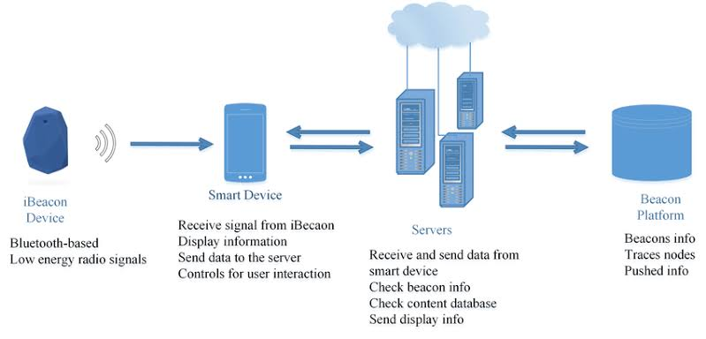
ARCHITECTURE OF BEACON TECHNOLOGY
Notes:
This is the architecture of beacon technology. In our case, a phone acts as both ibeacon device and smart device. It broadcasts the unique id through bluetooth based low energy radio signals. When another device comes in close proximity, it receives the id and sends the details to server, in our case flask server. The server process the data and send it to beacon platform which is neo4j database in our case. And the data flow takes place backwards to the smart device as well.

Slide 18
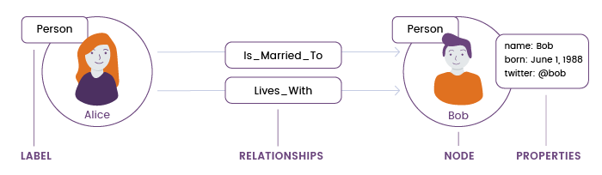
NEO4J DATABASE
Why NEO4J?
Schema-free
Real-time data analysis
Easy representation
Fast Execution
Easy retrieval of data
Notes:
Person, label properties of node.,Label is a name or identifier to a Node node has properties

Slide 19
IMPLEMENTATION DETAILS(CONTD..)
Creation of node and contact
Create nodes in graph upon registration
Initial probability set as zero
When contact made – relationship created with parameters
Contact Tracing by retrieving nodes in corresponding path
Probability assigned based on parameters

Slide 20
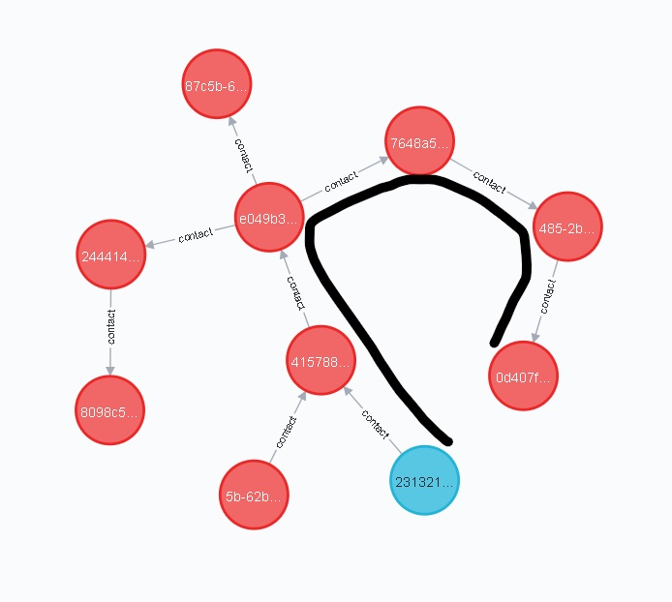
IMPLEMENTATION DETAILS(CONTD..)
Contact Tracing
Tracing contacts of a positive node
Determine path between nodes
Use cypher query to assign probability to nodes
Contact traced only when time_of_contact(second_level) > time_of_contact(first_level)
Notes:
Contact tracing done from blue node which is positve node,to end leaf node.where time of contact keeps increasing

Slide 21
IMPLEMENTATION DETAILS(CONTD..)
Source Identification
Shortest path between two positive node
Node with oldest contact time considered as source
Source node given alert
Notes:
Black tested positive first then blue according to our data prob of blue =0,then source found base on time of contact

Slide 22
RESULTS

Slide 23
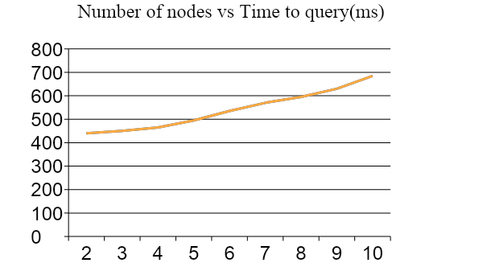
PERFORMANCE ANALYSIS
Graph
Tested on fully connected
graphs
Notes:
Worst case scenario of positive nodes,as nodes and relationships increase the time complexity increases.Python code to calculate

Slide 24
PERFORMANCE ANALYSIS
Comparison:
Features | R-Naught | Other Apps
Contact tracing | Up to five levels | Only one level
Source identification | Yes | No
Tracing different variants of viruses | Yes | No
Storage | Graph database | Local storage
Provides exposure measure of a nearby person to officials | Yes | No
Data collection | No privacy concern | Privacy concern

Slide 25
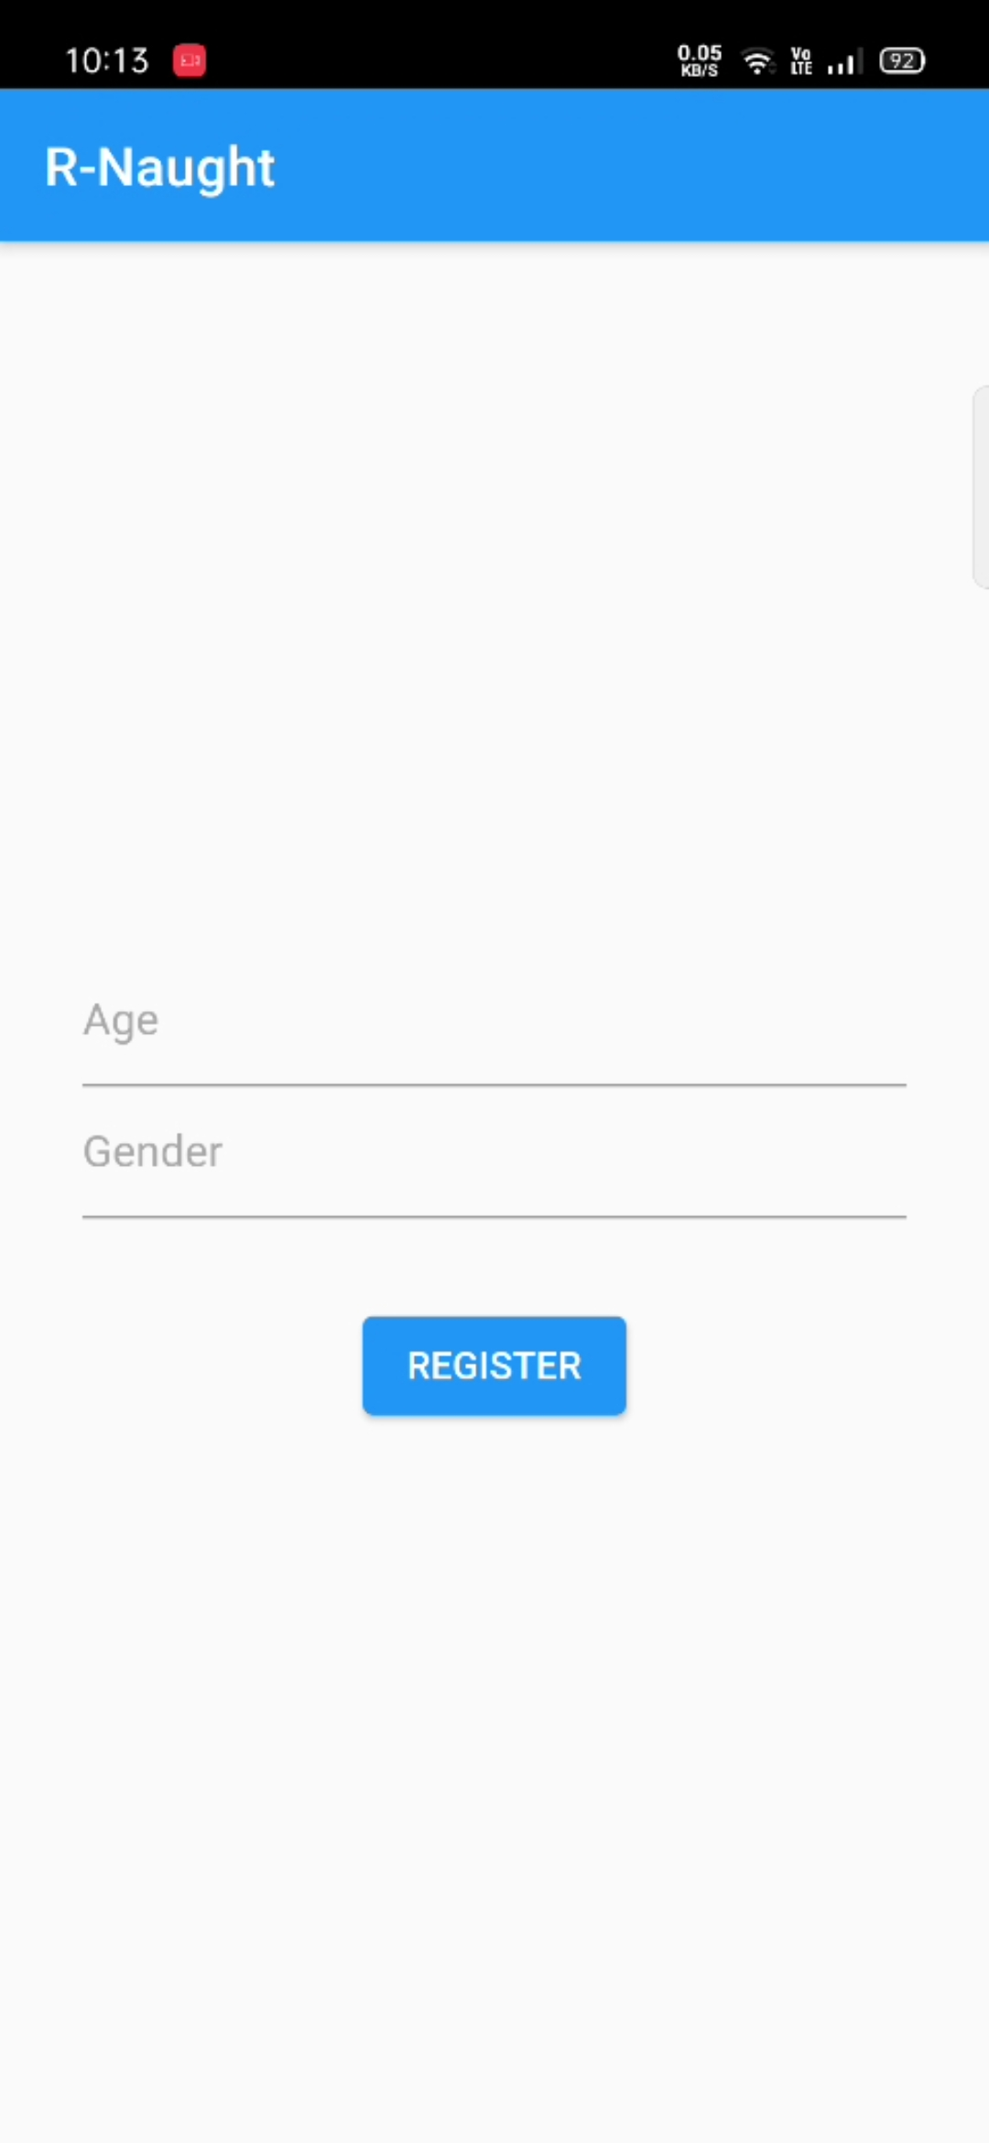
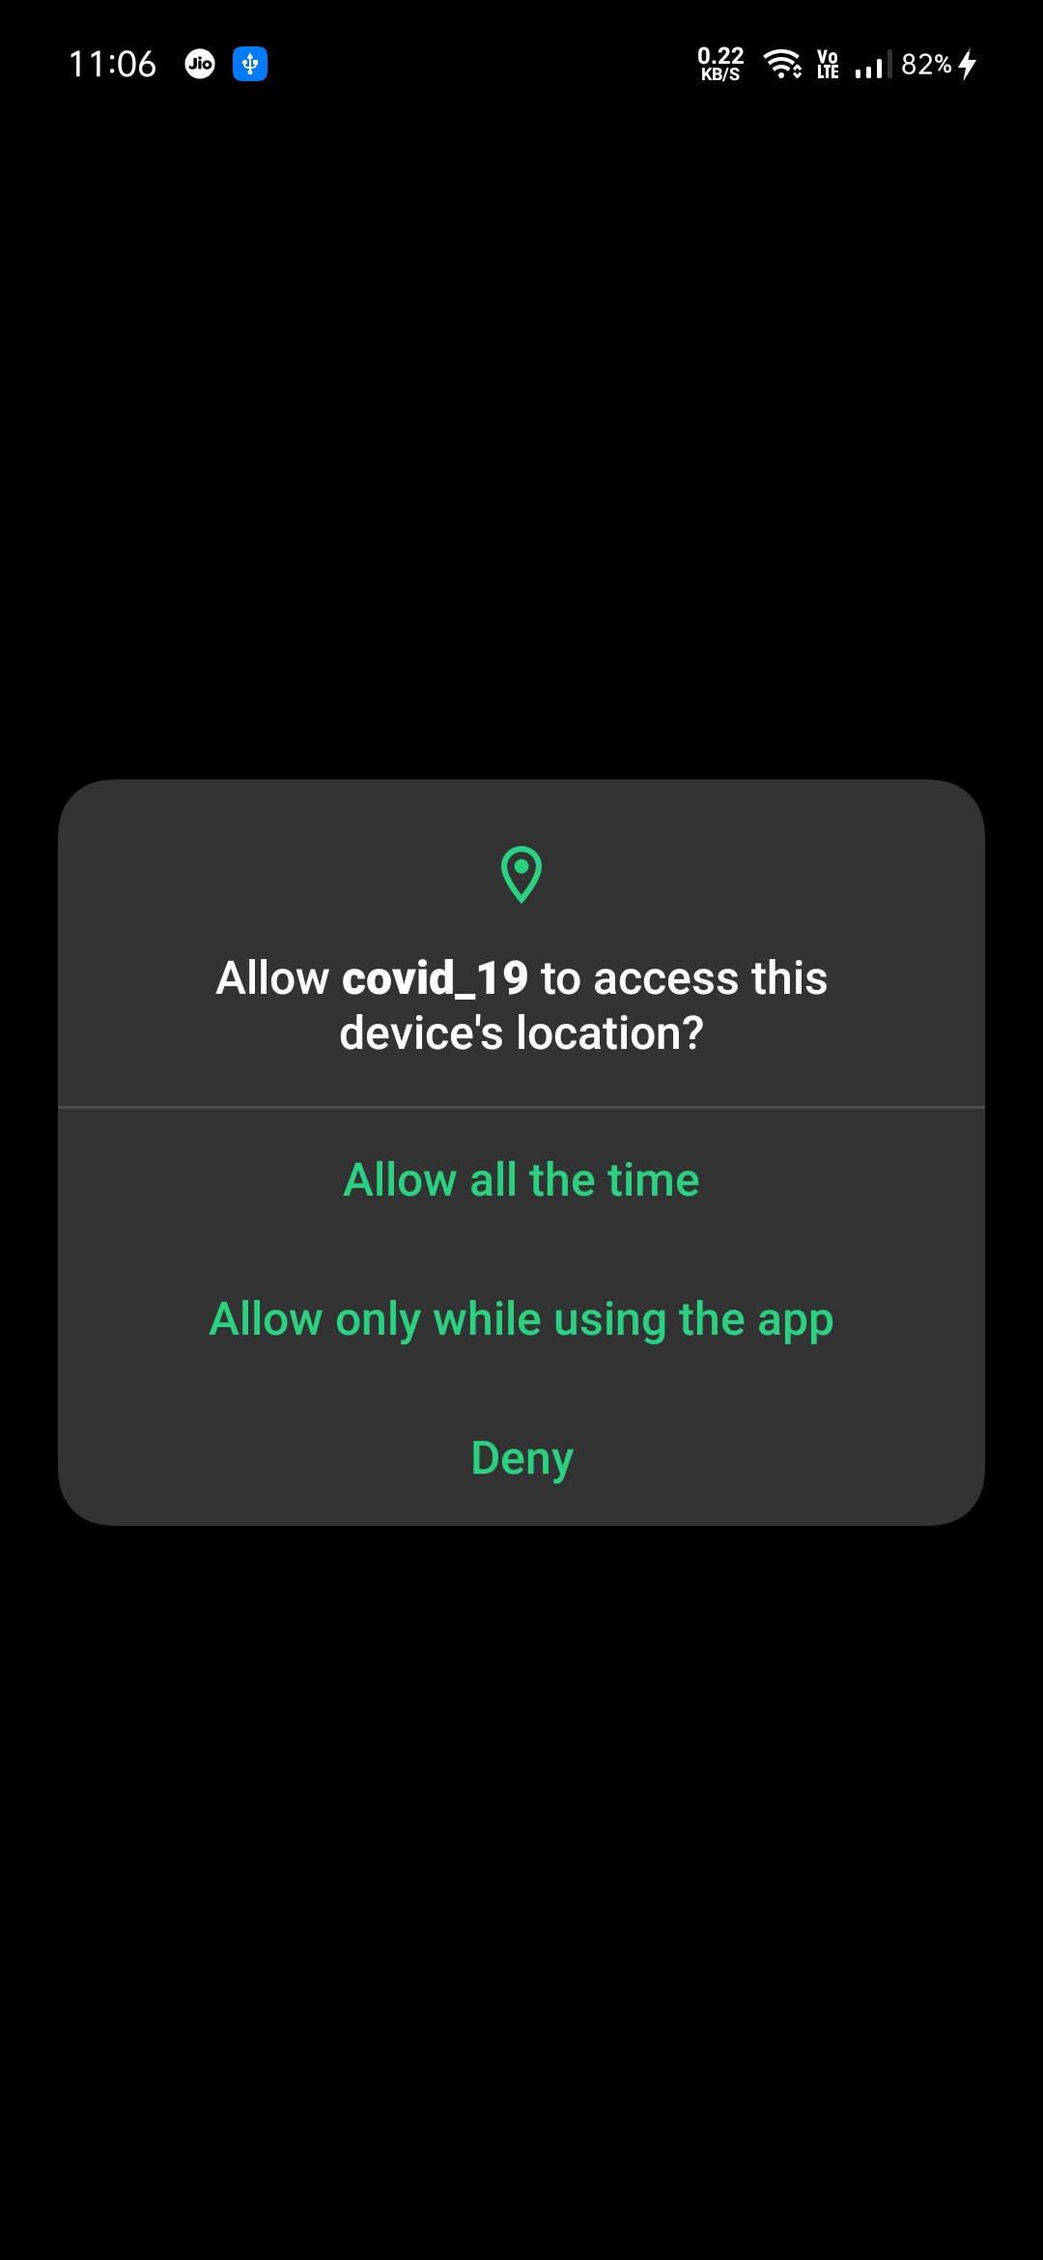
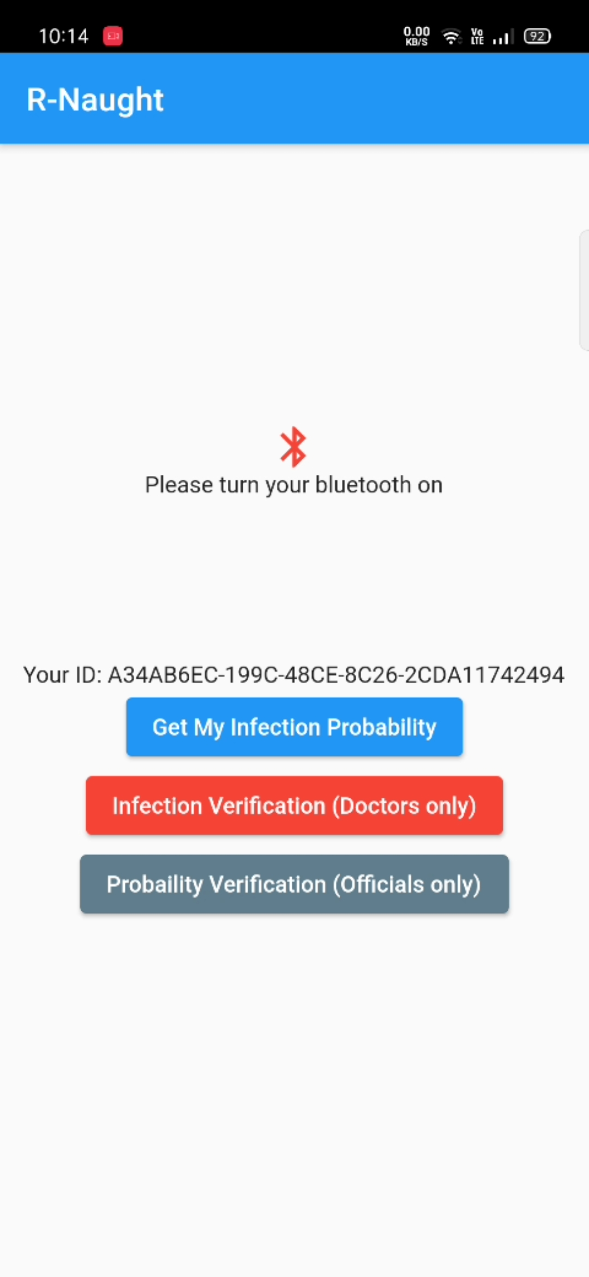
SCREENSHOTS (APP)
Classroom View

Slide 26
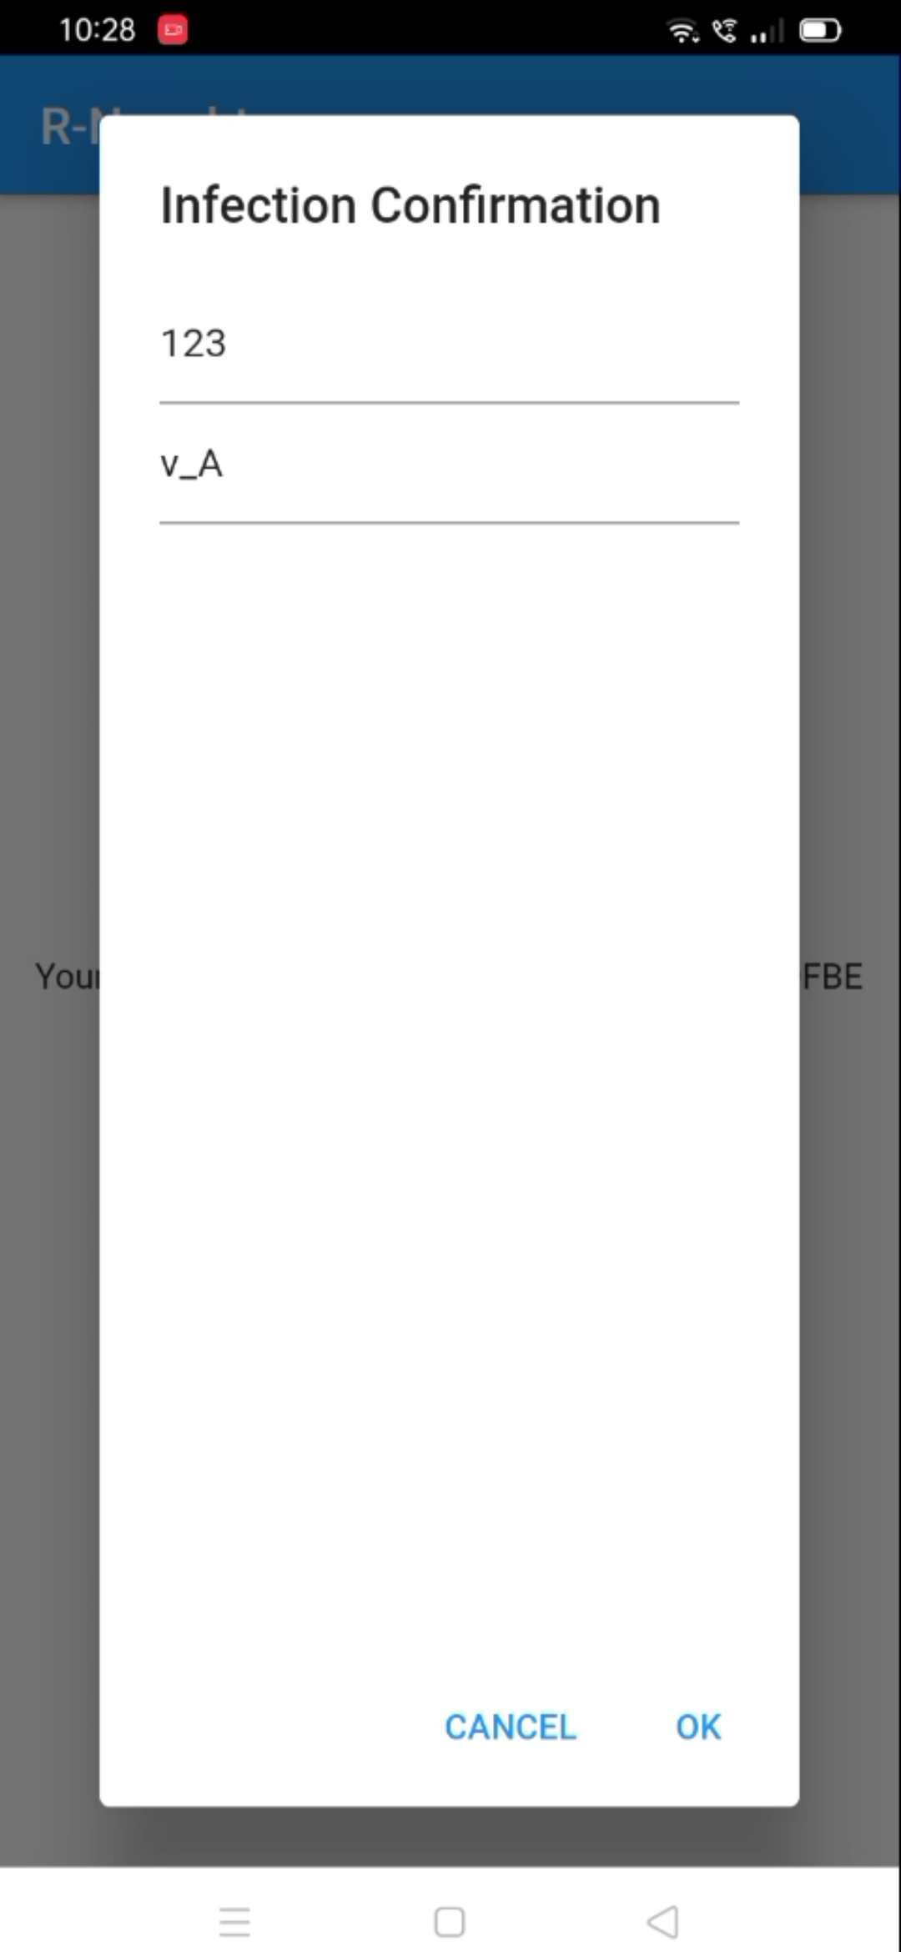
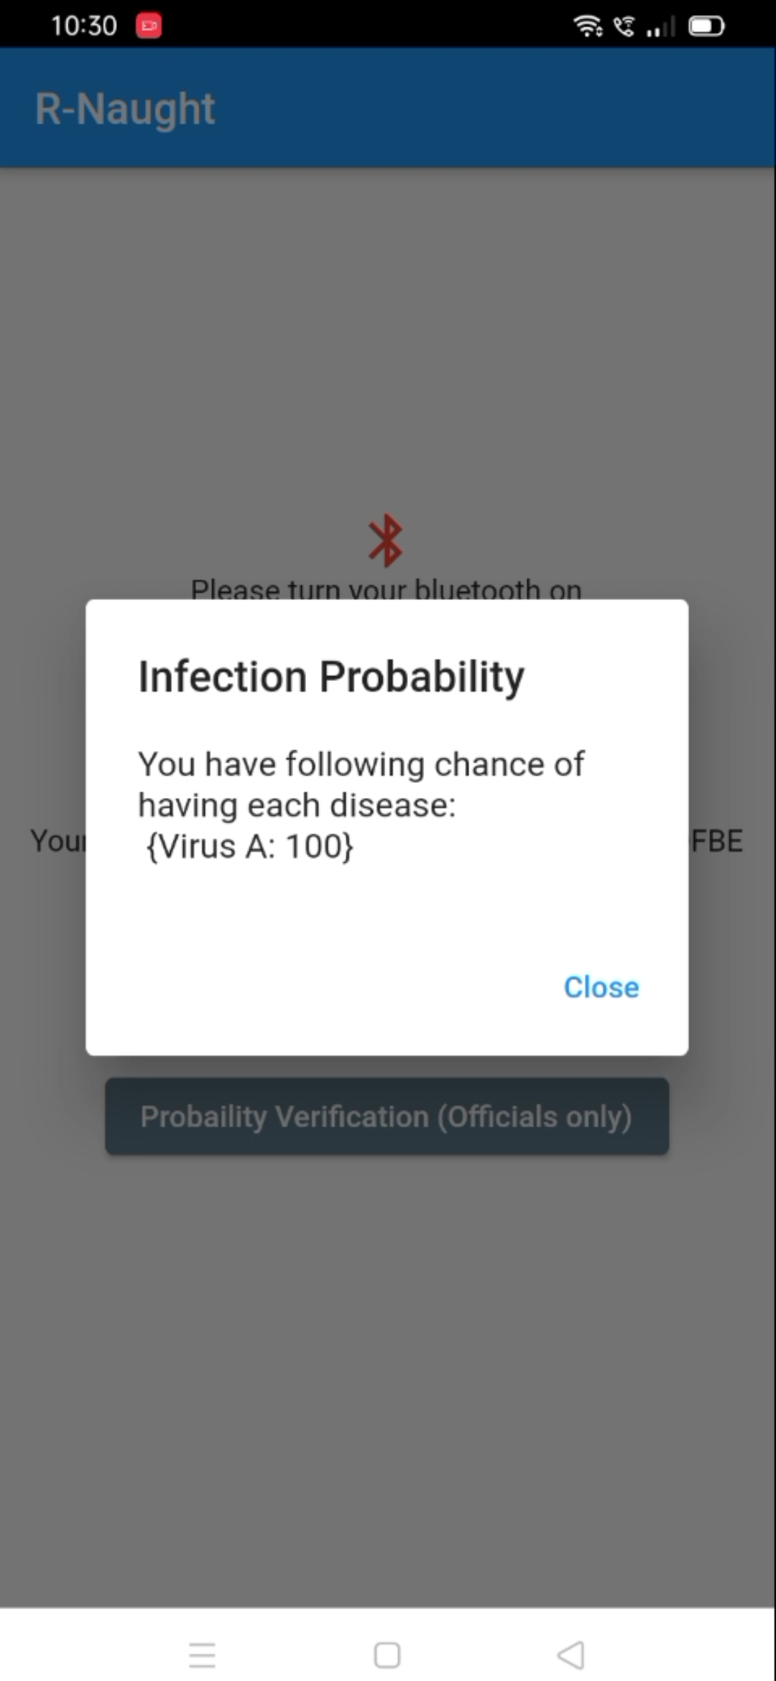
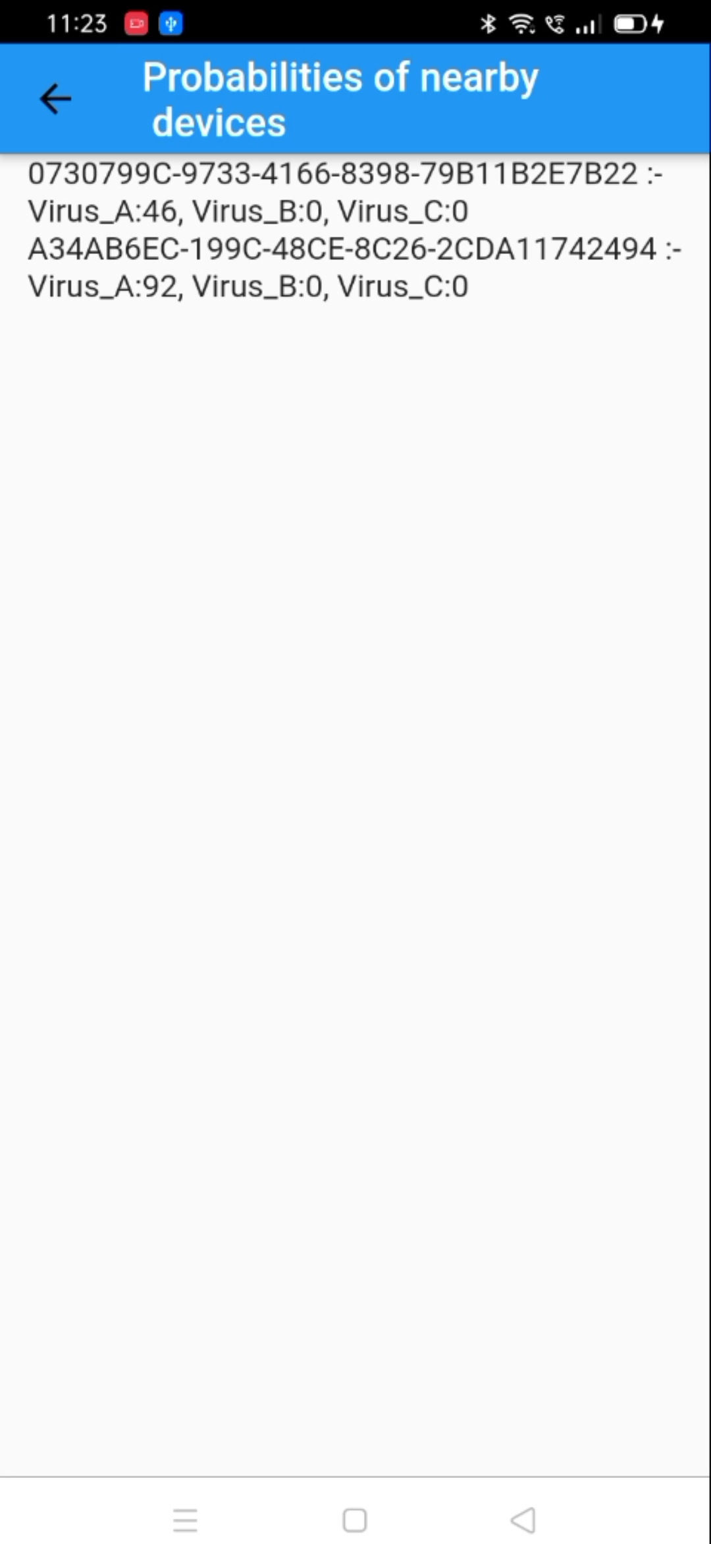
SCREENSHOTS (APP)

Slide 27
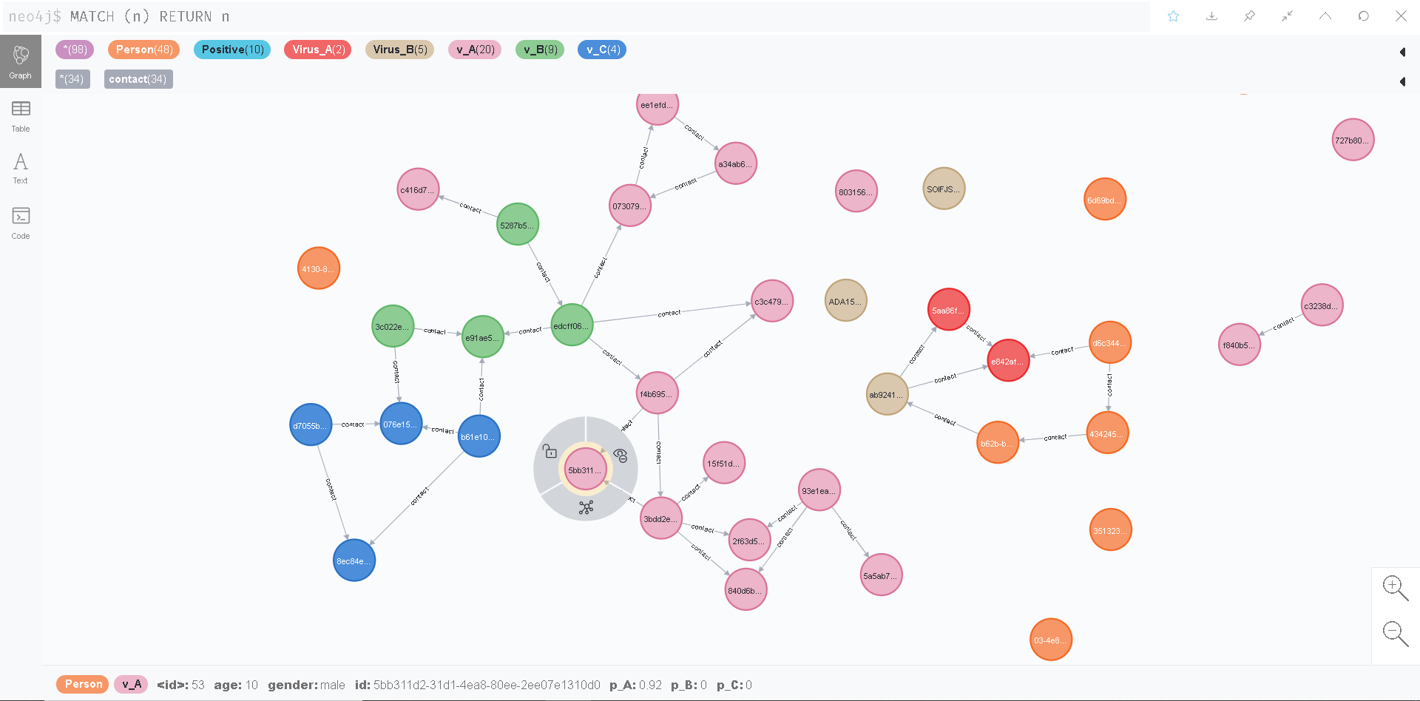
SCREENSHOT (NEO4J)

Slide 28
CONCLUSION
Can track patient clusters much more easily
Highly private and secure compared to other applications
Graph Database enables for easier traversal of data
Five levels of contact can be traced
Simple user interface reduces confusion among people
Self-quarantine can be promoted

Slide 29
REFERENCE
https://flutter.dev/docs/development/packages-and-plugins/using-packages
https://neo4j.com/learning-neo4j-book/
https://graphaware.com/

Slide 30
ACHIEVEMENTS
Applied for patent
Won first prize in an idea pitching competition

Slide 31
THANK YOU
Let’s pave way to a Corona free world

